Slide 1
SWITALSKIS MENTAL CAPACITY DAY CONFERENCE

Slide 2
Transparency & Third-Party Disclosure:
Should there be Limits to Public Access?
LORRAINE CAVANAGH KC
OCTOBER 2024

Slide 3
OPEN JUSTICE
“[1] Open justice. The words express a principle at the heart of our system of justice and vital to the rule of law. The rule of law is a fine concept but fine words butter no parsnips. How is the rule of law itself to be policed? It is an age old question. Quis custodiet ipsos custodes - who will guard the guards themselves? In a democracy, where power depends on the consent of the people governed, the answer must lie in the transparency of the legal process. Open justice lets in the light and allows the public to scrutinise the workings of the law, for better or for worse.”
Toulson LJ R (Guardian News and Media Ltd) v City of Westminster Magistrates’ Court (Article 19 intervening) [2012] EWCA Civ 420; [2013] QB 618

Slide 4
SECTION 12 ADMINSTRATION OF JUSTICE ACT 1960
12 Publication of information relating to proceedings in private.
The publication of information relating to proceedings before any court sitting in private shall not of itself be contempt of court except in the following cases, that is to say— ….
(b) where the proceedings are brought under the Mental Capacity Act 2005, or under any provision of the Mental Health Act 1983 authorising an application or reference to be made to the First-tier Tribunal, the Mental Health Review Tribunal for Wales or the county court; …

Slide 5
SECTION 12 ADMINSTRATION OF JUSTICE ACT 1960
(2) Without prejudice to the foregoing subsection, the publication of the text or a summary of the whole or part of an order made by a court sitting in private shall not of itself be contempt of court except where the court (having power to do so) expressly prohibits the publication.
(3) In this section references to a court include references to a judge and to a tribunal and to any person exercising the functions of a court, a judge or a tribunal; and references to a court sitting in private include references to a court sitting in camera or in chambers”.

Slide 6
WHAT IS NOT PREVENTED FROM PUBLICATION BY S12
Section 12 of the AJA and what is does not restrict publication of:
The fact that Y is subject to any order/declaration under the MCA or MHA 1986 or the IJ or was subject to an order under the Children Act 1989.
The name, address or photograph of Y.
The name, address or photograph of the parties (or other parties than Y) to such proceedings.
The date, time or place of past or future hearings of such proceedings.
The nature of the dispute in such proceedings.

Slide 7
WHAT IS NOT PREVENTED FROM PUBLICATION BY S12
“anything which has been seen or heard by a person conducting himself lawfully in the public corridor or other public precincts outside the court in which the hearing in private is taking place”
the name, address or photograph of the witnesses who have given evidence in such proceedings.
the party on whose behalf such a witness has given evidence; and
the text or summary of the whole or part of any order made in such proceedings.
As per Munby J in his judgment in Re B (a child) (disclosure) [2004] EWHC 411 (Fam) at [82](v)-(vii), [2004] 3 FCR 1 at [82](v)-(vii); see also [64]–[65]. Cited with approval by the COA in Clayton v Clayton [2006] EWCA Civ 878

Slide 8
WHAT IS PREVENTED FROM PUBLICATION BY S12?
The term ‘information relating to the proceedings’ includes (thus section 12 prohibits the publication of) the following:
accounts of what has gone on in front of the judge sitting in private.
documents such as affidavits, witness statements, reports, position statements, skeleton arguments or other documents filed in the proceedings, transcripts or notes of the evidence or submissions, and transcripts or notes of the judgment (this list is not necessarily exhaustive).
extracts or quotations from such documents.
summaries of such documents.
Munby J in his judgment in Re B (a child) (disclosure) [2004] EWHC 411 (Fam) at [82](v)-(vii), [2004] 3 FCR 1 at [82](v)-(vii); see also [64]–[65]. Also Munby J, as he then was, in A v Ward [2010] EWHC 16 (Fam), [2010] 1 FLR 1497, paragraphs 1124-114; also

Slide 9
Section 12 AJA 1960
Section 12 is concerned with what goes on inside the courtroom during hearings before a judge and the evidence/material before the judge.
Section 12 protects the proceedings before the court
Section 12 does not specifically protect information about P.
Not all material before the court is protected by section 12 Munby J (as he then was) see A v Ward [2010] EWHC 16 (Fam), [2010] 1 FLR 1497, at paragraphs 112-114.
When the section is disapplied by the transparency order, where does that leave third party disclosure to the public?

Slide 10
COURT OF PROTECTION RULES 2017
Rule 4.3 - Court’s power to order that a hearing be held in public
4.3.—(1) The court may make an order—
(a) for a hearing to be held in public;
(b) for a part of a hearing to be held in public; or
(c) excluding any person, or class of persons, from attending a public hearing or a part of it.
(2) Where the court makes an order under paragraph (1), it may in the same order or by a subsequent order—
(a) impose restrictions on the publication of the identity of—
(i) any party;
(ii) P (whether or not a party);
(iii) any witness; or
(iv) any other person;

Slide 11
RULE 4.3 (2) CONTINUED
(b) prohibit the publication of any information that may lead to any such person being identified;
(c) prohibit the further publication of any information relating to the proceedings from such date as the court may specify; or
(d) impose such other restrictions on the publication of information relating to the proceedings as the court may specify.
Rule 4.3 relates to the court’s actions of allowing a hearing to be held in public and when making an order for that purpose it may impose restrictions of the publication of information protecting P, parties and witnesses and information before the court.

Slide 12
THE RULES PROVIDING FOR PUBLIC HEARINGS
Practice Direction 4C CoPR 2017, at 2.1. :
“[t]he court will ordinarily (and so without any application being made)— (a) make an order under rule 4.3(1)(a) that any attended hearing shall be in public; and (b) in the same order, impose restrictions under rule 4.3(2) in relation to the publication of information about the proceedings.

Slide 13
THE TRANSPARENCY ORDER
Disapplies section 12 AJA 1960. Deems case to sit in public.
Restrains publication of any material or information that identifies or is likely to identify:
(a) P, protected person;
(b) any person is a member of the family of P.
Restrains publication of any material or information that identifies or is likely to identify where any person listed above lives, or is being cared for, or their contact details.
Charles J (VP) in V v Associated Newspapers Ltd & Ors [2016] EWCOP 21 drew a distinction between the making of an RRO and an anonymity order made under the COP Rules.
For this reason, the orders have been directed at those who attend the hearing and those that they inform, about its contents rather than the public at large.

Slide 14
DURATION OF THE TRANSPARENCY ORDER
The template order provides as follows:
This Injunction shall have effect until [ until further order of the Court ] [ the death of THE INITIALS CHOSEN TO IDENTIFY P] [X weeks / months after the death of THE INITIALS CHOSEN TO IDENTIFY P].
The template contemplates no term of the order or review period- once made it lasts until death or beyond death, in some cases.
Is that lawful within European jurisprudence? Is it consistent with European case law?
The Supreme Court is determining this issue on appeal from the decision of the Lord Chief Justice in Abbasi & Anor v Newcastle Upon Tyne Hospitals NHS Foundation Trust [2023] EWCA Civ 331 [2023] Fam 287, [2023] 3 WLR 575.

Slide 15
DISCLOSURE OF TRANSCRIPTS
The CoPR 2017 do not address application of a transcript of evidence or proceedings held in public.
the Rules do not provide for an issue then the ‘Application of the Civil Procedure Rules and Family Procedure Rules’ applies.
Rule 2.5 states -
“—(1) In any case not expressly provided for by these Rules or the practice directions made under them, the court may apply either the Civil Procedure Rules 1998(7) or the Family Procedure Rules 2010(8) (including in either case the practice directions made under them) with any necessary modifications, in so far as is necessary to further the overriding objective.”

Slide 16
TRANSCRIPTS- CPR 1998
The CPR 1989 expressly deals with third party applications for a transcript.
Rule 39.9 CPR 1998 requires proceedings to be recorded and provides that any party or other person may request a transcript, a fee would need to be paid, and they should be provided with one.
Practice Direction (Audio Recordings of Proceedings: Access) [2014] 1 WLR 632 clarifies that there is no right for a party or a non-party to listen to the recording.
Baroness Hale in Dring stated at paragraph 25 that “…[n]evertheless, the effect of rule 39.9 (which is wider than its predecessor) is that a non-party can (at a fee) obtain a transcript of everything that was said in court.”

Slide 17
Rule 5.9 Non Party Disclosure
Part 5.9 the ‘Supply of documents to a non-party from court records’
“5.9.—(1) Subject to rules 5.12 and 4.3(2), a person who is not a party to proceedings may inspect or obtain from the court records a copy of any judgment or order given or made in public.
(2) The court may, on an application made to it, authorise a person who is not a party to proceedings to—
inspect any other documents in the court records; or
obtain a copy of any such documents, or extracts from such documents.
(3) A person making an application for an authorisation under paragraph (2) must do so in accordance with Part 10.
(4) Before giving an authorisation under paragraph (2), the court will consider whether any document is to be provided on an edited basis.

Slide 18
Court records- what are they?
Supreme Court decision of Cape Intermediate Holdings Ltd v Dring [2019] UKSC 38 Lady Hale held that “the records of the court” for the purposes of the equivalent Civil Procedure Rule were-
“The “records of the court” must therefore refer to those documents and records which the court itself keeps for its own purposes. It cannot refer to every single document generated in connection with a case and filed, lodged or kept for the time being at court. It cannot depend upon how much of the material lodged at court happens still to be there when the request is made” (emphasis added)

Slide 19
Court Records
These include:
“a claim form or other statement of case together with any documents filed with or attached to or intended by the claimant to be served with such claim form”;
“an acknowledgement of service together with any documents filed with or attached to or intended by the party acknowledging service to be served with such acknowledgement of service”;
“an application notice”, with two exceptions, and “any written evidence filed in relation to an application”,
with the same two exceptions; “a judgment or order made in public (whether made at a hearing or without a hearing)”; and
“a list of documents”.
It does not include witness statements for trial, experts’ reports for trial, transcripts of hearings, or trial bundles”

Slide 20
DISCLOSURE OF DOCUMENTS: POSITION STATEMENTS
Aside from a judgment or court order there is no right of the public to have any other documents.
An application may be made for documents on the court record- which would include a PS
The transparency orders do not contain an exemption for position statements.
Although a convention has developed to hand those out to bloggers or journalists who request them strictly under the Rules that is a court discretionary decision and there should be a reflection of the permission to do so drafted into the order.
On the COP transparency working group we are reviewing the standard order and I will raise this. We note that the transparency order made under the pilot in the Family Court hasd a term directing the service of anonymoised position statements/case suammries etc.

Slide 21
THIRD PARTY DISCLOSURE OF THE EVIDENCE
Dring v Cape Intermediate Holdings Ltd [2019] UKSC 38
“[38] In a case where documents have been placed before a judge and referred to in the course of proceedings, in my judgment the default position should be that access should be permitted on the open justice principle; and where access is sought for a proper journalistic purpose, the case for allowing it will be particularly strong. However, there may be countervailing reasons. … I do not think that it is sensible or practical to look for a standard formula for determining how strong the grounds of opposition need to be in order to outweigh the merits of the application. The court has to carry out a proportionality exercise which will be fact-specific. Central to the court’s evaluation will be the purpose of the open justice principle, the potential value of the material in advancing that purpose and, conversely, any risk of harm which access to the documents may cause to the legitimate interests of others.” [my emphasis]

Slide 22
DRING
There is no standard formula for an application by a third party for disclosure of information relating to the proceedings in a public hearing it is a proportionality exercise which will be fact specific.
The Supreme Court held that-
“[41] [i]t follows that, unless inconsistent with statute or the rules of court, all courts and tribunals have an inherent jurisdiction to determine what that principle requires in terms of access to documents or other information placed before the court or tribunal in question.”

Slide 23
DRING PRINCIPLES
Baroness Hale set out the following principles-
The first principle of open justice is “…to enable public scrutiny of the way in which courts decide cases - to hold the judges to account for the decisions they make and to enable the public to have confidence that they are doing their job properly”
The second principle is to “…enable the public to understand how the justice system works and why decisions are taken”. The public has “…to be in a position to understand the issues and the evidence adduced in support of the parties’ cases” for this to met.
“The public should be allowed access, not only to the parties’ written submissions and arguments, but also to the documents which have been placed before the court and referred to during the hearing. It follows that it should not be limited to those which the judge has been asked to read or has said that he has read.”

Slide 24
DRING PRINCIPLES
“…the court has the power to allow access, the applicant has no right to be granted it (save to the extent that the rules grant such a right).”
“It is for the person seeking access to explain why he seeks it and how granting him access will advance the open justice principle. In this respect it may well be that the media are better placed than others to demonstrate a good reason for seeking access. But there are others who may be able to show a legitimate interest in doing so.”
“…the court has to carry out a fact-specific balancing exercise.”
“On the one hand will be “the purpose of the open justice principle and the potential value of the information in question in advancing that purpose”

Slide 25
DRING PRINCIPLES
On the other hand will be “any risk of harm which its disclosure may cause to the maintenance of an effective judicial process or to the legitimate interests of others”
There may be very good reasons for denying access. The most obvious ones are national security, the protection of the interests of children or mentally disabled adults, the protection of privacy interests more generally, and the protection of trade secrets and commercial confidentiality…”

Slide 26
Re Z [2019] EWCOP 55
Mr Justice Morgan in Re Z [2019] EWCOP 55 (Court of Protection& Business & Property Court).
Application by the brother of P, a non-party to the COP proceedings, for various disclosure, including the expert medical reports.
Morgan J. applied the Dring principles to this third party disclosure application. Supreme Court decision of Dring
Emphasising that the court had to carry out a fact-specific balancing exercise
on one hand would be the purpose of the open justice principle and the potential value of the information in advancing that purpose, and
on the other hand would be the legitimate interests of others.
The practicalities and the proportionality of granting the request.
The application was refused as the disclosure sought was not necessary having regard to the reasons given

Slide 27
Re AB (Court of Protection: Police Disclosure) [2019] EWCOP 66
An application by the police for disclosure of material out of the COP proceedings for the furtherance of their investigation.
The law was agreed by counsel and not determined by the learned judge
“Mr O'Brien, on behalf of the Official Solicitor, submitted that the court should adopt the criteria set out in Re C (A Minor) (Care Proceedings: Disclosure) [1997] 2 WLR 322 mutatis mutandis to the Court of Protection. Mr Palmer, on behalf of the police, accepted that submission. It is conceded by Mr O'Brien that when determining the application for disclosure of the expert reports, the court is not applying a best interests test but would be applying the Re C test.”
Keehan J held that the Re C adapted for COP proceedinsg wer ethe applicable principles.

Slide 28
RE C (A MINOR) [1997] 2 WLR 322
As per Swinton Thomas LJ [Family Case sitting in Private] the following principles will be considered on an application for police disclosure out of the Family Division/Family Court:
The welfare and interests of the child or children concerned in the care proceedings. If the child is likely to be adversely affected by the order in any serious way, this will be a very important factor;
The welfare and interests of other children generally;
The maintenance of confidentiality in children’s cases;
The importance of encouraging frankness in children’s cases. All parties to this appeal agree that this is a very important factor and is likely to be of particular importance in a case to which section 98(2) applies. The underlying purpose of section 98 is to encourage people to tell the truth in cases concerning children, and the incentive is that any admission will not be admissible in evidence in a criminal trial.

Slide 29
Re C Principles
…Consequently, it is important in this case. However, the added incentive of guaranteed confidentiality is not given by the words of the section and cannot be given;
The public interest in the administration of justice. Barriers should not be erected between one branch of the judicature and another inimical to the overall interests of justice;
The public interest in the prosecution of serious crime and the punishment of offenders, including the public interest in convicting those who have been guilty of violent or sexual offences against children. There is a strong public interest in making available material to the police which is relevant to a criminal trial. In many cases, this is likely to be a very important factor;

Slide 30
Re C Principles
The gravity of the alleged offence and the relevance of the evidence to it. If the evidence has little or no bearing on the investigation or the trial, this will militate against a disclosure order;
The desirability of cooperation between various agencies concerned with the welfare of children, including the social services departments, the police service, medical practitioners, health visitors, schools etc. This is particularly important in cases concerning children;
In a case to which section 98(2) applies, the terms of the section itself, namely that the witness was not excused from answering incriminating questions, and that any statement of admission would not be admissible against him in criminal proceedings. Fairness to the person who has incriminated himself and any others affected by the incriminating statement and any danger of oppression would also be relevant considerations;
Any other material disclosure which has already taken place.

Slide 31
THIRD PARTY APPLICATIONS IN THE COP
Drawing together Dring and Re C- some possible principles for application
The welfare and interests of P. not taking a ‘best interests’ decision Consideration of the welfare of P relates to the act of disclosure itself.
The maintenance of confidentiality in Court of Protection. General rule being that Court of Protection hearings are largely held in public subject to reporting restrictions.
The importance of encouraging frankness/P’s engagement.
The public interest in the administration of justice
The furtherance of open justice in public proceedings.
The purpose of the disclosure request
The proportionality/scope of the disclosure request

Slide 32
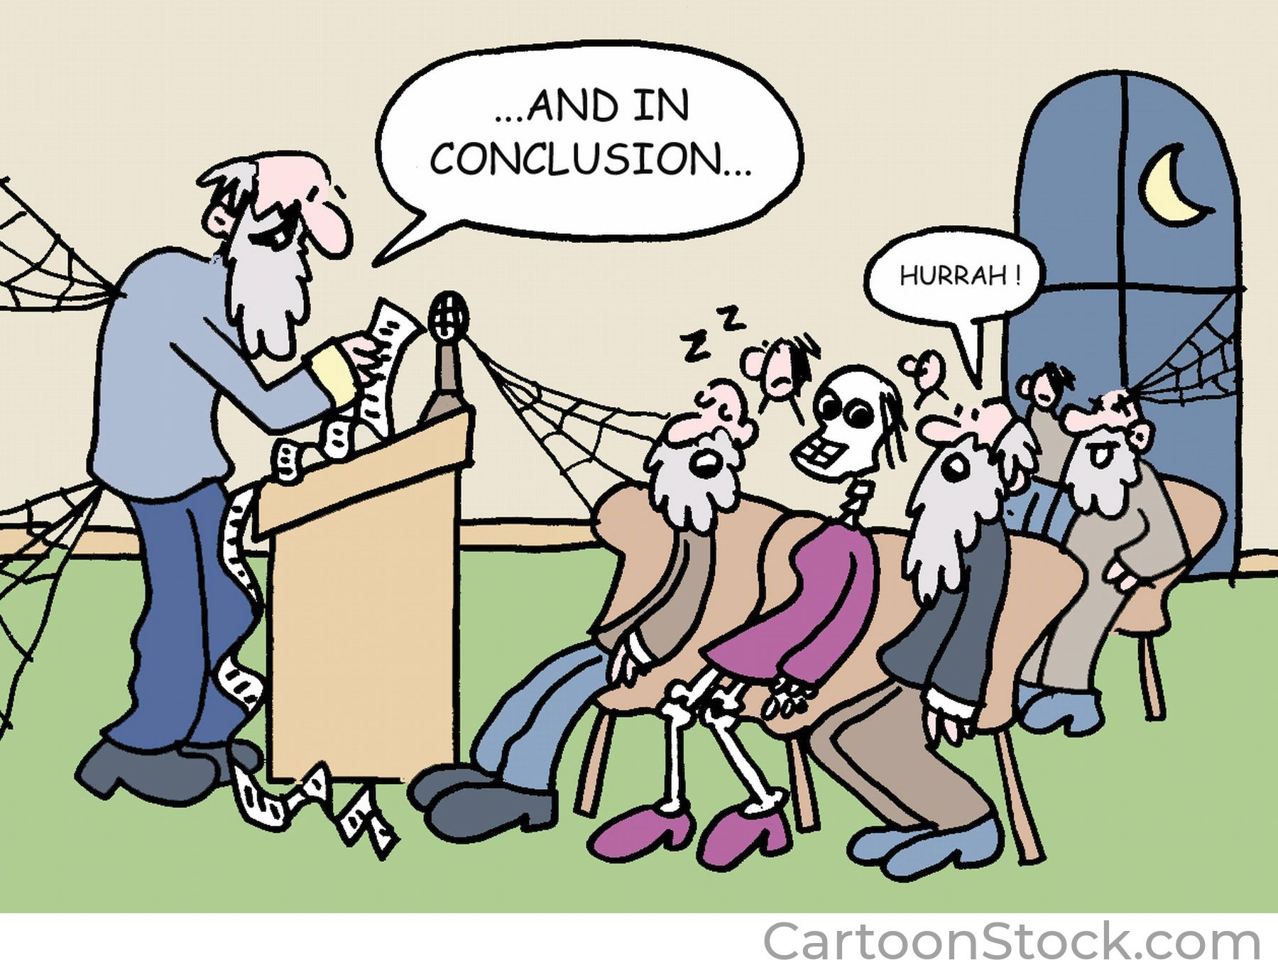
Page without header – for images, quotes etc

