Slide 1
P can understand, retain, but not weigh
Dr Faisal Parvez
MBBS, MRCPsych, DipPsych, PGCert MedED + HCL
Consultant in Old Age Psychiatry
Pennine Care NHS Foundation Trust
Special Medical Visitor
Independent Expert
f.parvez@nhs.net

Slide 2
No declarations of interest
Special Visitor for approximately 10 years
Assessments for the OPG
COP - Section 49
Independent expert
Notes:
Talk on my experience of reporting for past 10 years in MCA cases and 20 years of clinical experience of assessing patients with cognitive impairments.

Slide 3
Aims of presentation
What is the ability to weigh?
Assessments and cognitive screening
4 more common case vignettes
Practice pointers
How to identify problems with weighing ability
What is executive dysfunction?
Underlying conditions associated with difficulties in weighing
Notes:
Tailoring assessment for suspected impairments in weighing ability

Slide 4
What is the ability to weigh?
Understand - comprehend, grasp explanation, perceive meaning.
Retain - continue to hold, keep possession of.
Use or weigh information - consider, deliberate, foresee consequences and effects.
Communicate - by any means 'eye blink' case.

Slide 5
Consider: The brain must bring the relevant facts into its "working memory" all at once. An individual with executive dysfunction might understand Fact A (e.g., "I have no food left") and Fact B (e.g., "I have money in my wallet"), but their brain cannot actively hold and consider both pieces of information simultaneously to plan a trip to the shop.
Cognitive function: Working memory
Notes:
Holding information leading to a goal directed behaviour.

Slide 6
Deliberate: This involves balancing pros and cons, comparing choices, and selecting the safest or most logical path. Executive dysfunction often leads to rigid thinking, impulsivity, or hyper-focusing on a single irrelevant detail, completely derailing the ability to deliberate.
Cognitive function: Flexibility in thinking

Slide 7
Foresee Consequences: This requires abstract thought and the ability to look forward into the future. A person with an executive gap struggles to project the outcomes of their current behavior (e.g., failing to see that refusing a care package today will lead to a health crisis or hospital admission next week).
Cognitive function: abstract thinking

Slide 8
Big 3 Cognitive functions plus some others
Working memory
Flexible thinking
Abstract thinking
Problem solving
Impulsivity
Inhibitory control
Notes:
Weighing is the most difficult aspect to evidence and elicit from the 4 aspects in relation to MCA.
In my experience most assessments where there is disagreement, contention, or opposing opinions using relate to the assessment of weighing where I have given 2nd opinions.

Slide 9
What is executive dysfunction?
“Executive functions represent a constellation of cognitive abilities that drive goal- oriented behaviour”
Rabinovici GD, Stephens ML, Possin KL. Executive dysfunction. Continuum (Minneap Minn). 2015;21(3 Behavioral
Neurology and Neuropsychiatry):646-659.
Executive functions can be split into four distinct components:
working memory
inhibition
set shifting
fluency
Notes:
Disorder which is of working memory, flexible thinking, and abstract thinking.

Slide 10
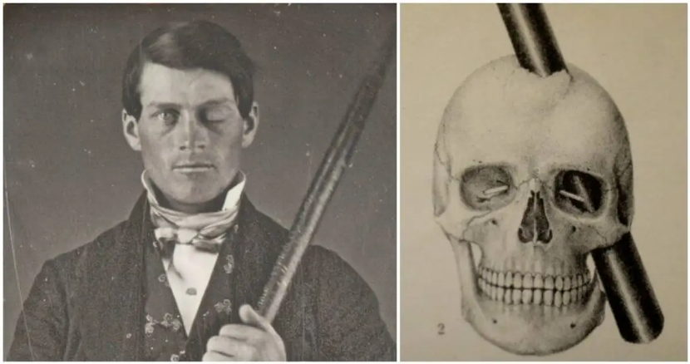
What is executive dysfunction?
The case of Phineas Gage (1838)
19th and 20th understanding of frontal lobe syndrome and hypo-frontalism leading to modern understanding of executive function
Modern definition – “cognitive processes of flexible thinking, working memory and inhibition” involving structures in frontal, temporal and parietal lobes: Dorsolateral prefrontal, anterior & posterior cingulate, thalamus, basal ganglia, superior parietal and hippocampus
Notes:
Date & Location: September 13, 1848, near Cavendish, Vermont. [1]
What Happened: While 25-year-old Gage used a heavy iron tamping rod (3 feet 7 inches long, weighing 13.2–13.5 lbs) to pack gunpowder into a rock, a spark ignited the charge. [1, 2, 3]
The Injury: The blast drove the iron rod straight through his left cheekbone, behind his left eye, and out through the top of his skull, landing 25 to 30 yards away
Once a capable, polite, and well-balanced manager, he became fitful, irreverent, profane, impatient, and unable to stick to plans or social rules
Gage's skull and the tamping iron are preserved and displayed at the Harvard Medical School

Slide 11
In 1975, Blumer and Benson reviewed 140 years of literature on personality changes after frontal lobe injury and concluded that there are two types of changes:
“pseudopsychopathic,” associated with orbital prefrontal damage, and “pseudodepressed,” associated with damage to the prefrontal convexity.

Slide 12
Present as capable and well
Overtalkative / circumstantial vs depressive / withdrawn
Score well on cognitive screening tests
Evidence from actions and behaviours
Impulsive
Semantic errors

Slide 13
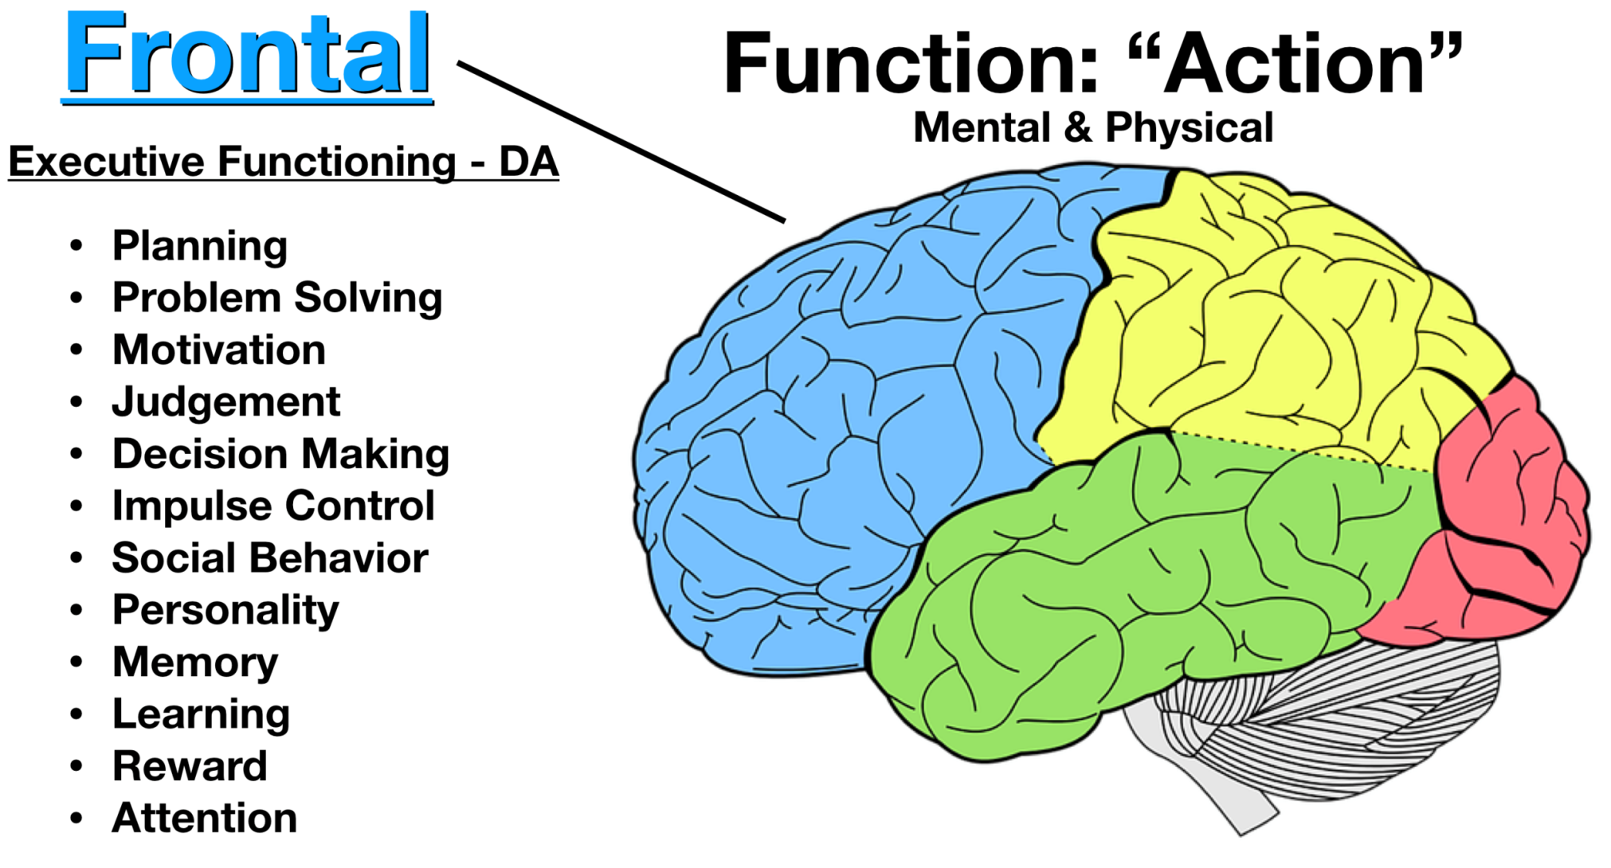

Slide 14
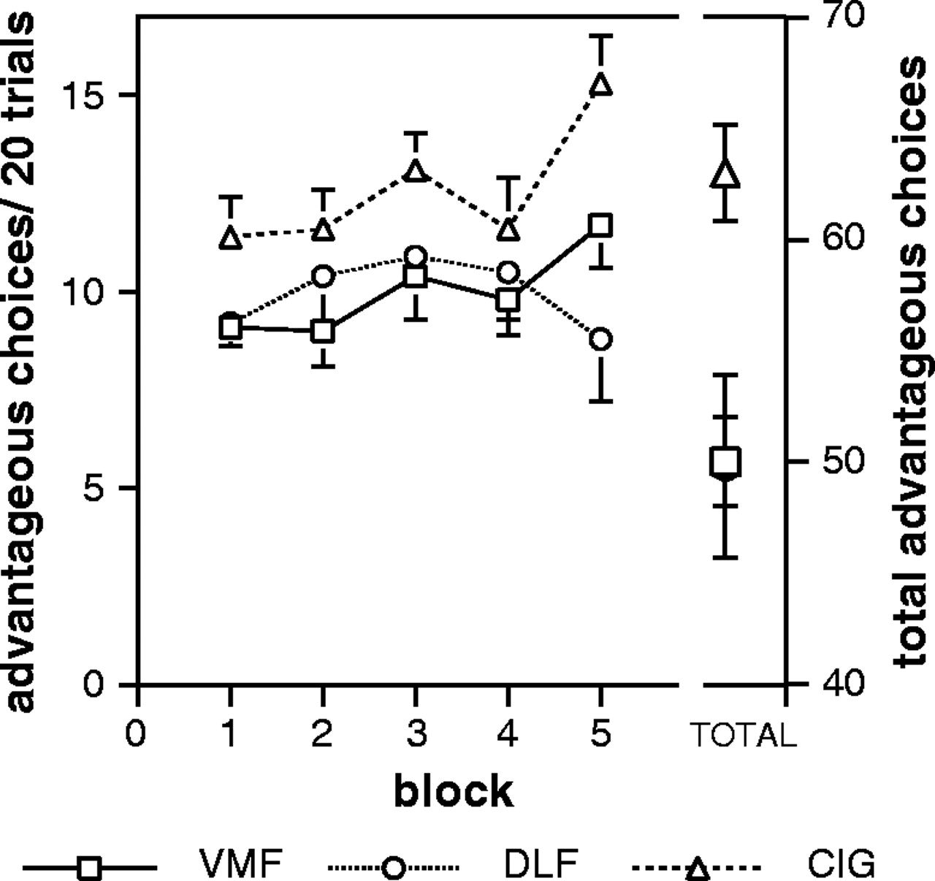
Different Underlying Impairments in Decision-making Following Ventromedial and Dorsolateral Frontal Lobe
Damage in Humans, Cerebral Cortex, Volume 15, Issue 1, January 2005, Pages 58–63, https://doi.org/10.1093/cercor/bhh108
Notes:
The control group made significantly more advantageous choices than either frontal group.

Slide 15
Behaviour
Say-do gap:
This is known as the ‘frontal lobe paradox’, which is when they can ‘talk the talk’ but ‘not walk the walk’
Real-world failure: In day-to-day life, they cannot sequence, initiate, or execute the plan safely (e.g., self-neglect, hoarding, or repeated risky choices).
Distinction from unwise decisions: An unwise decision happens when someone understands the risk and consciously chooses it; executive dysfunction happens when the brain cannot access, integrate, or apply the relevant facts in real time
Notes:
Unable to evaluate as part of their behaviour.

Slide 16
NICE guidance NG1081
Executive function is mentioned in National Institute for Health and Care Excellence (NICE) guidance NG1081
Structured assessments of capacity for individuals in this group (for example, by way of interview) may therefore need to be supplemented by real-world observation of the person's functioning and decision-making ability in order to provide the assessor with a complete picture of an individual's decision making ability.

Slide 17
Assessment and cognitive screening
Cognitive screening tools:
Range of tests
Premorbid education
Most are screening tools for cognitive impairments
Can be useful in providing an insight into the level of Impairment or measuring objectively
To predict cognitive decline over time
Some too impaired to take part
Most are poor at identifying executive dysfunction

Slide 18
Bedside tests
Cognitive estimates
Similarities
Sequencing
Proverbs
Letter and category fluency
Luria motor test

Slide 19
3D Assessment (Neil Allen)
Assessment of the individual
Collateral information
Real world information

Slide 20

4 vignettes
70 year old man with schizophrenia and hoarding
60 year old man with atypical dementia syndrome and disinhibited behaviour
55 year old woman with alcohol dependence and self neglect
25 year old woman with learning disability and spending impulsively

Slide 21
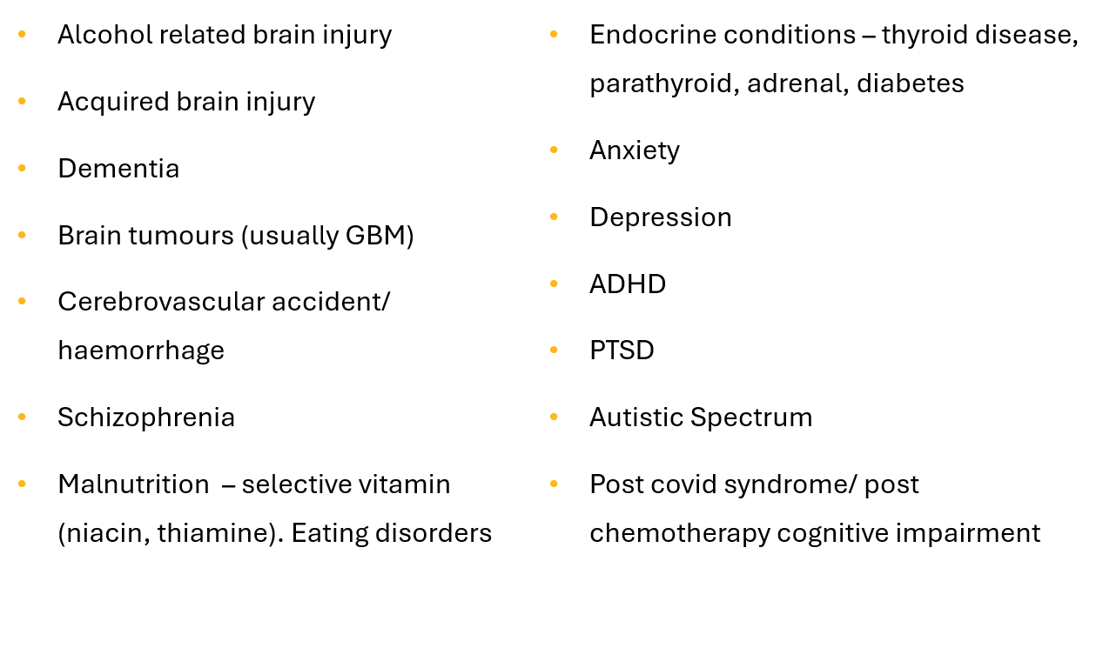
Underlying conditions associated with difficulties in weighing

Slide 22
Practise pointers
Gather
Gather collateral information: Talk to family, informal carers, and support staff who observe daily living patterns and real-world implementation.
Review
Review historical patterns: Look for a repeated mismatch between abstract intentions and concrete actions across past records.
Document
Document the mismatch: examples of mismatch between verbalisation and behaviour.
Use
Use real world evidence: examples of actual behaviour
Notes:
Structured routines and neuropsych assessment

Slide 23
Warrington Borough Council v Y [2023] EWCOP 27
The Facts: Y was a young woman with a traumatic brain injury (TBI) who demonstrated "superficial plausibility." In formal interviews, she could articulate her needs perfectly, saying, "I know I need support." However, in everyday life, she engaged in highly dangerous, impulsive behaviors.
A Local Authority v AW [2020] EWCOP 24
The Facts: AW was a 35-year-old man with autism and a mild learning disability. While he could express simple choices verbally, severe executive functioning deficits stopped him from identifying daily life risks.

Slide 24

Learning from case law
Remember that difficulties with executive function or a diagnosis of executive dysfunction is not in itself evidence of a lack of mental capacity. Evidence for the functional and diagnostic tests are required.
Evidence needs to be collated of whether the individual can (or not) implement what they verbally report in the abstract in relation to the decision.
This includes evidence mismatches between verbal reports and practical action.
Any difficulty must be linked back to a cognitive impairment for a lack of mental capacity to be determined.
Notes:
Structures routines may help reduce impulsivity and behavioural aspects.

Slide 25
The terms executive functioning and executive capacity are not referenced in the Mental Capacity Act or the MCA Code of Practice

Slide 26
Thankyou!
Any questions
F.Parvez@nhs.net

